Slide 1
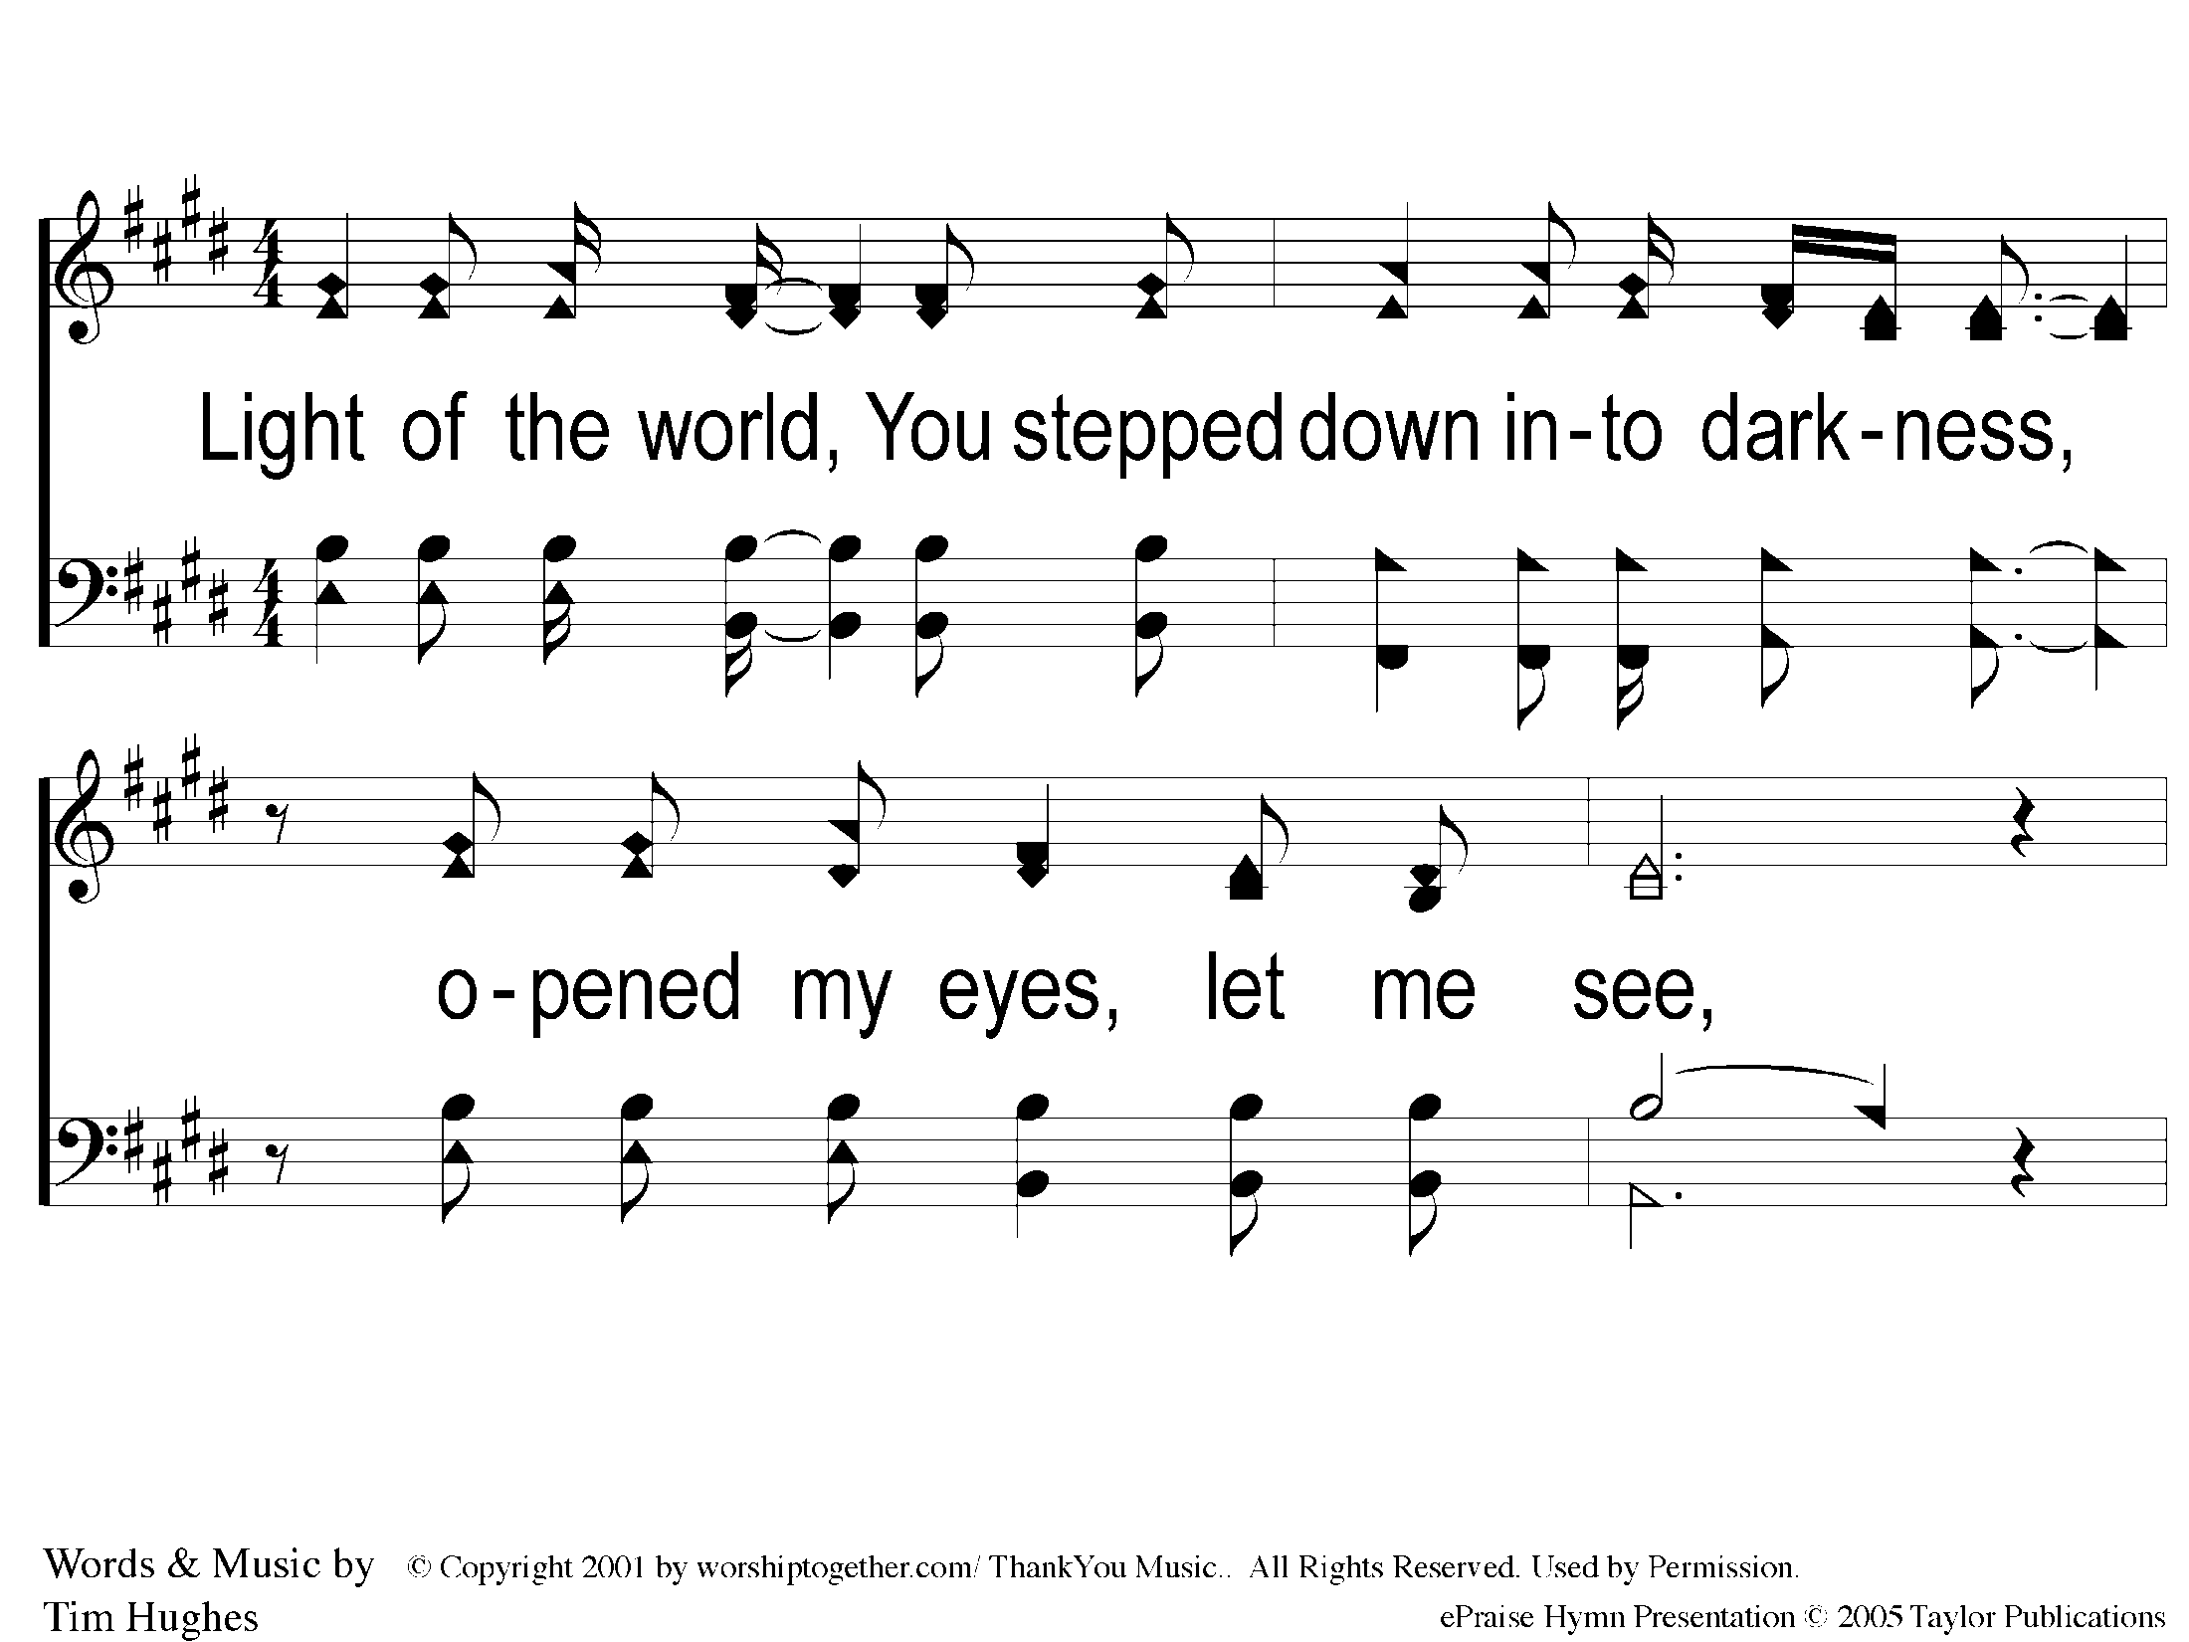
1-1 Here I Am To Worship
Here I Am To Worship

Slide 2
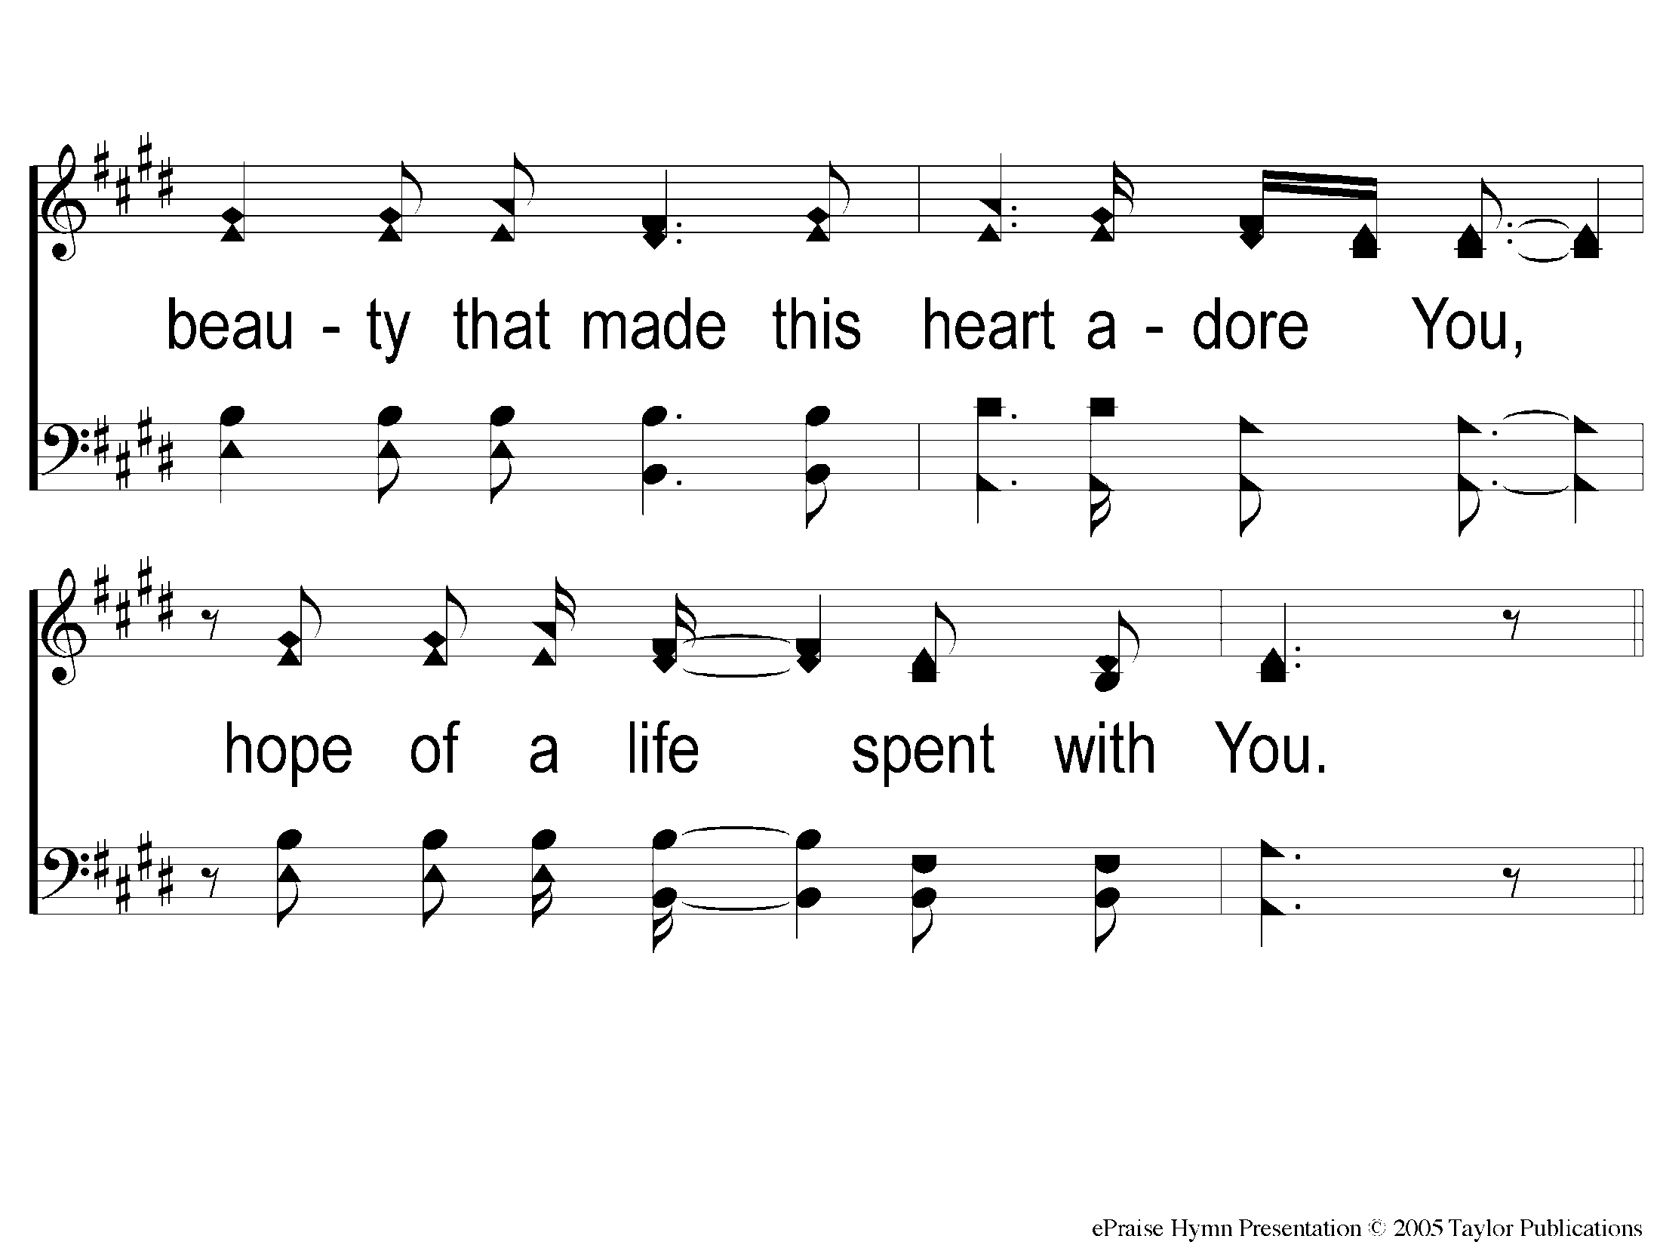
1-2 Here I Am To Worship
Here I Am To Worship

Slide 3
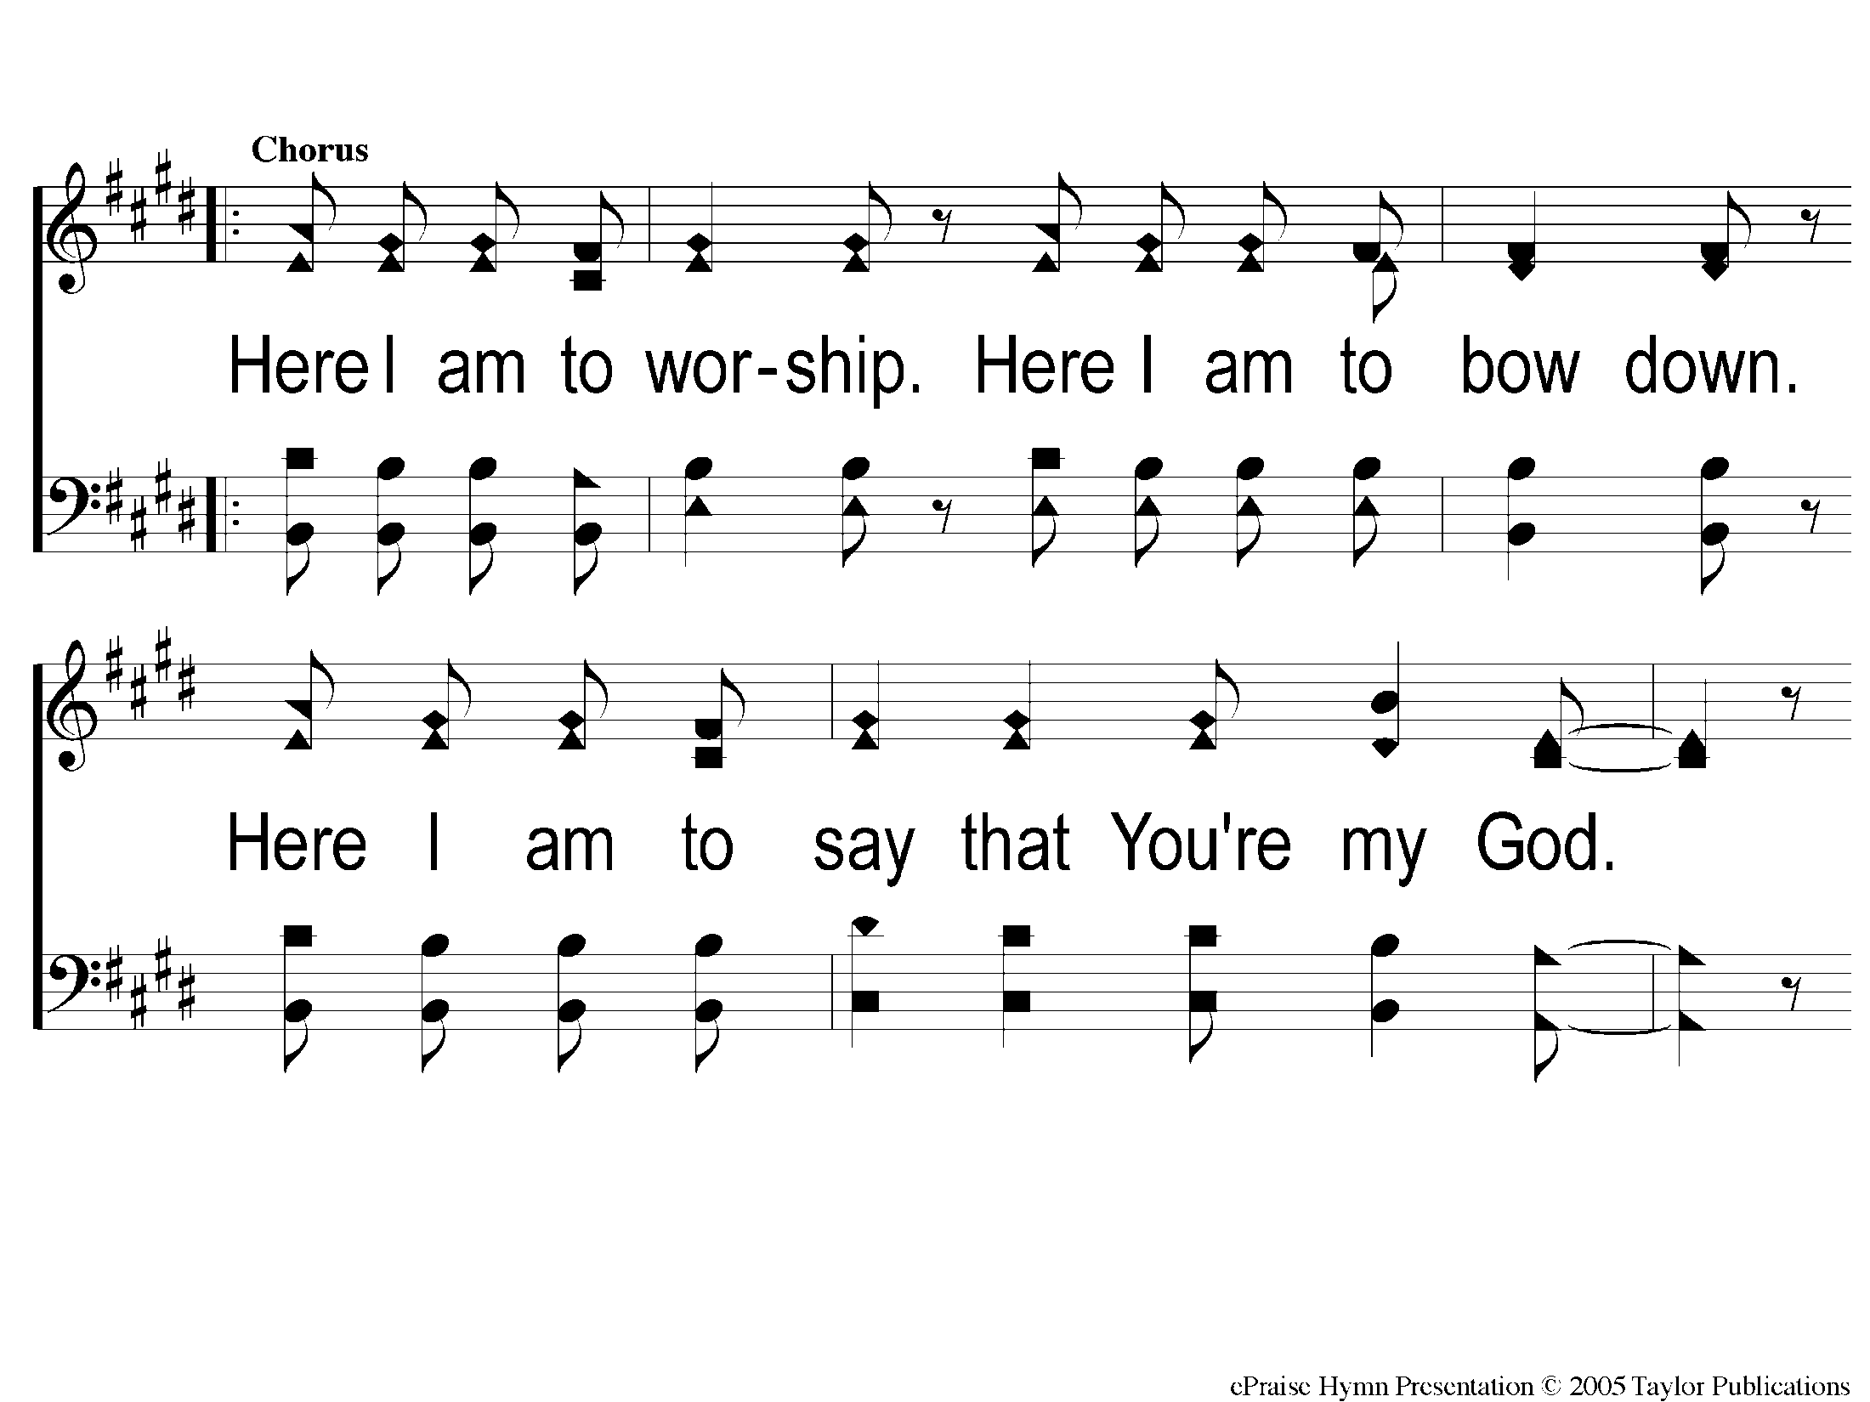
C-1 Here I Am To Worship
Here I Am To Worship

Slide 4
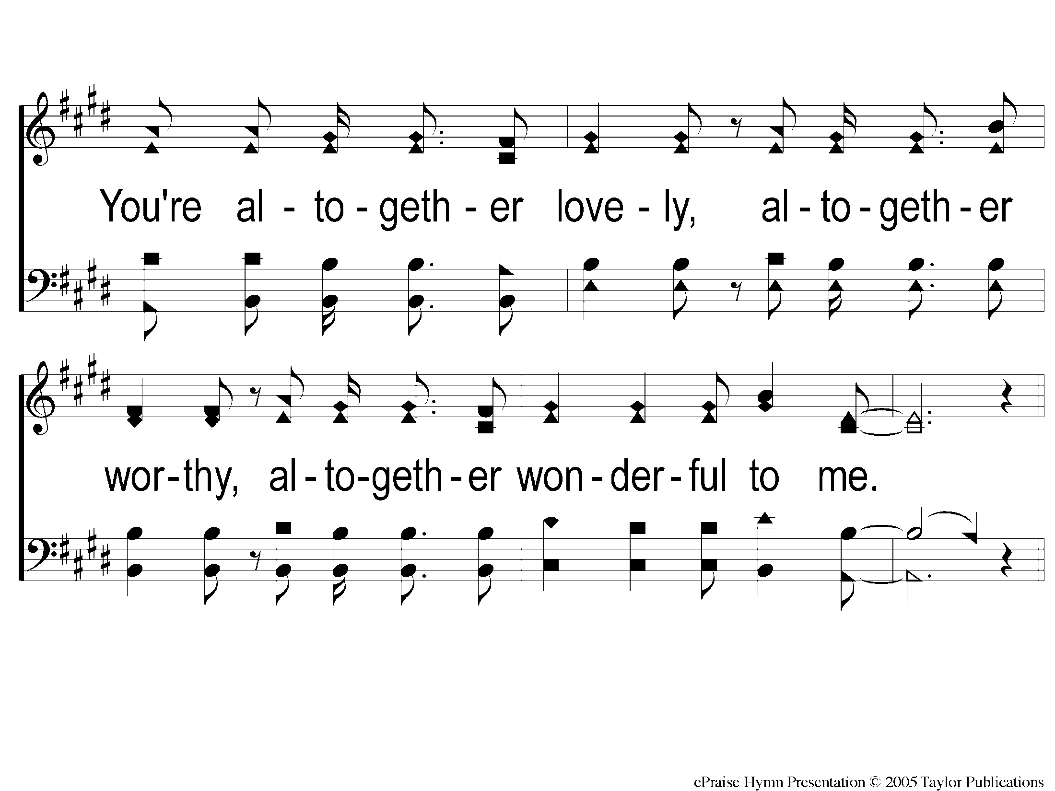
C-2 Here I Am To Worship
Here I Am To Worship

Slide 5
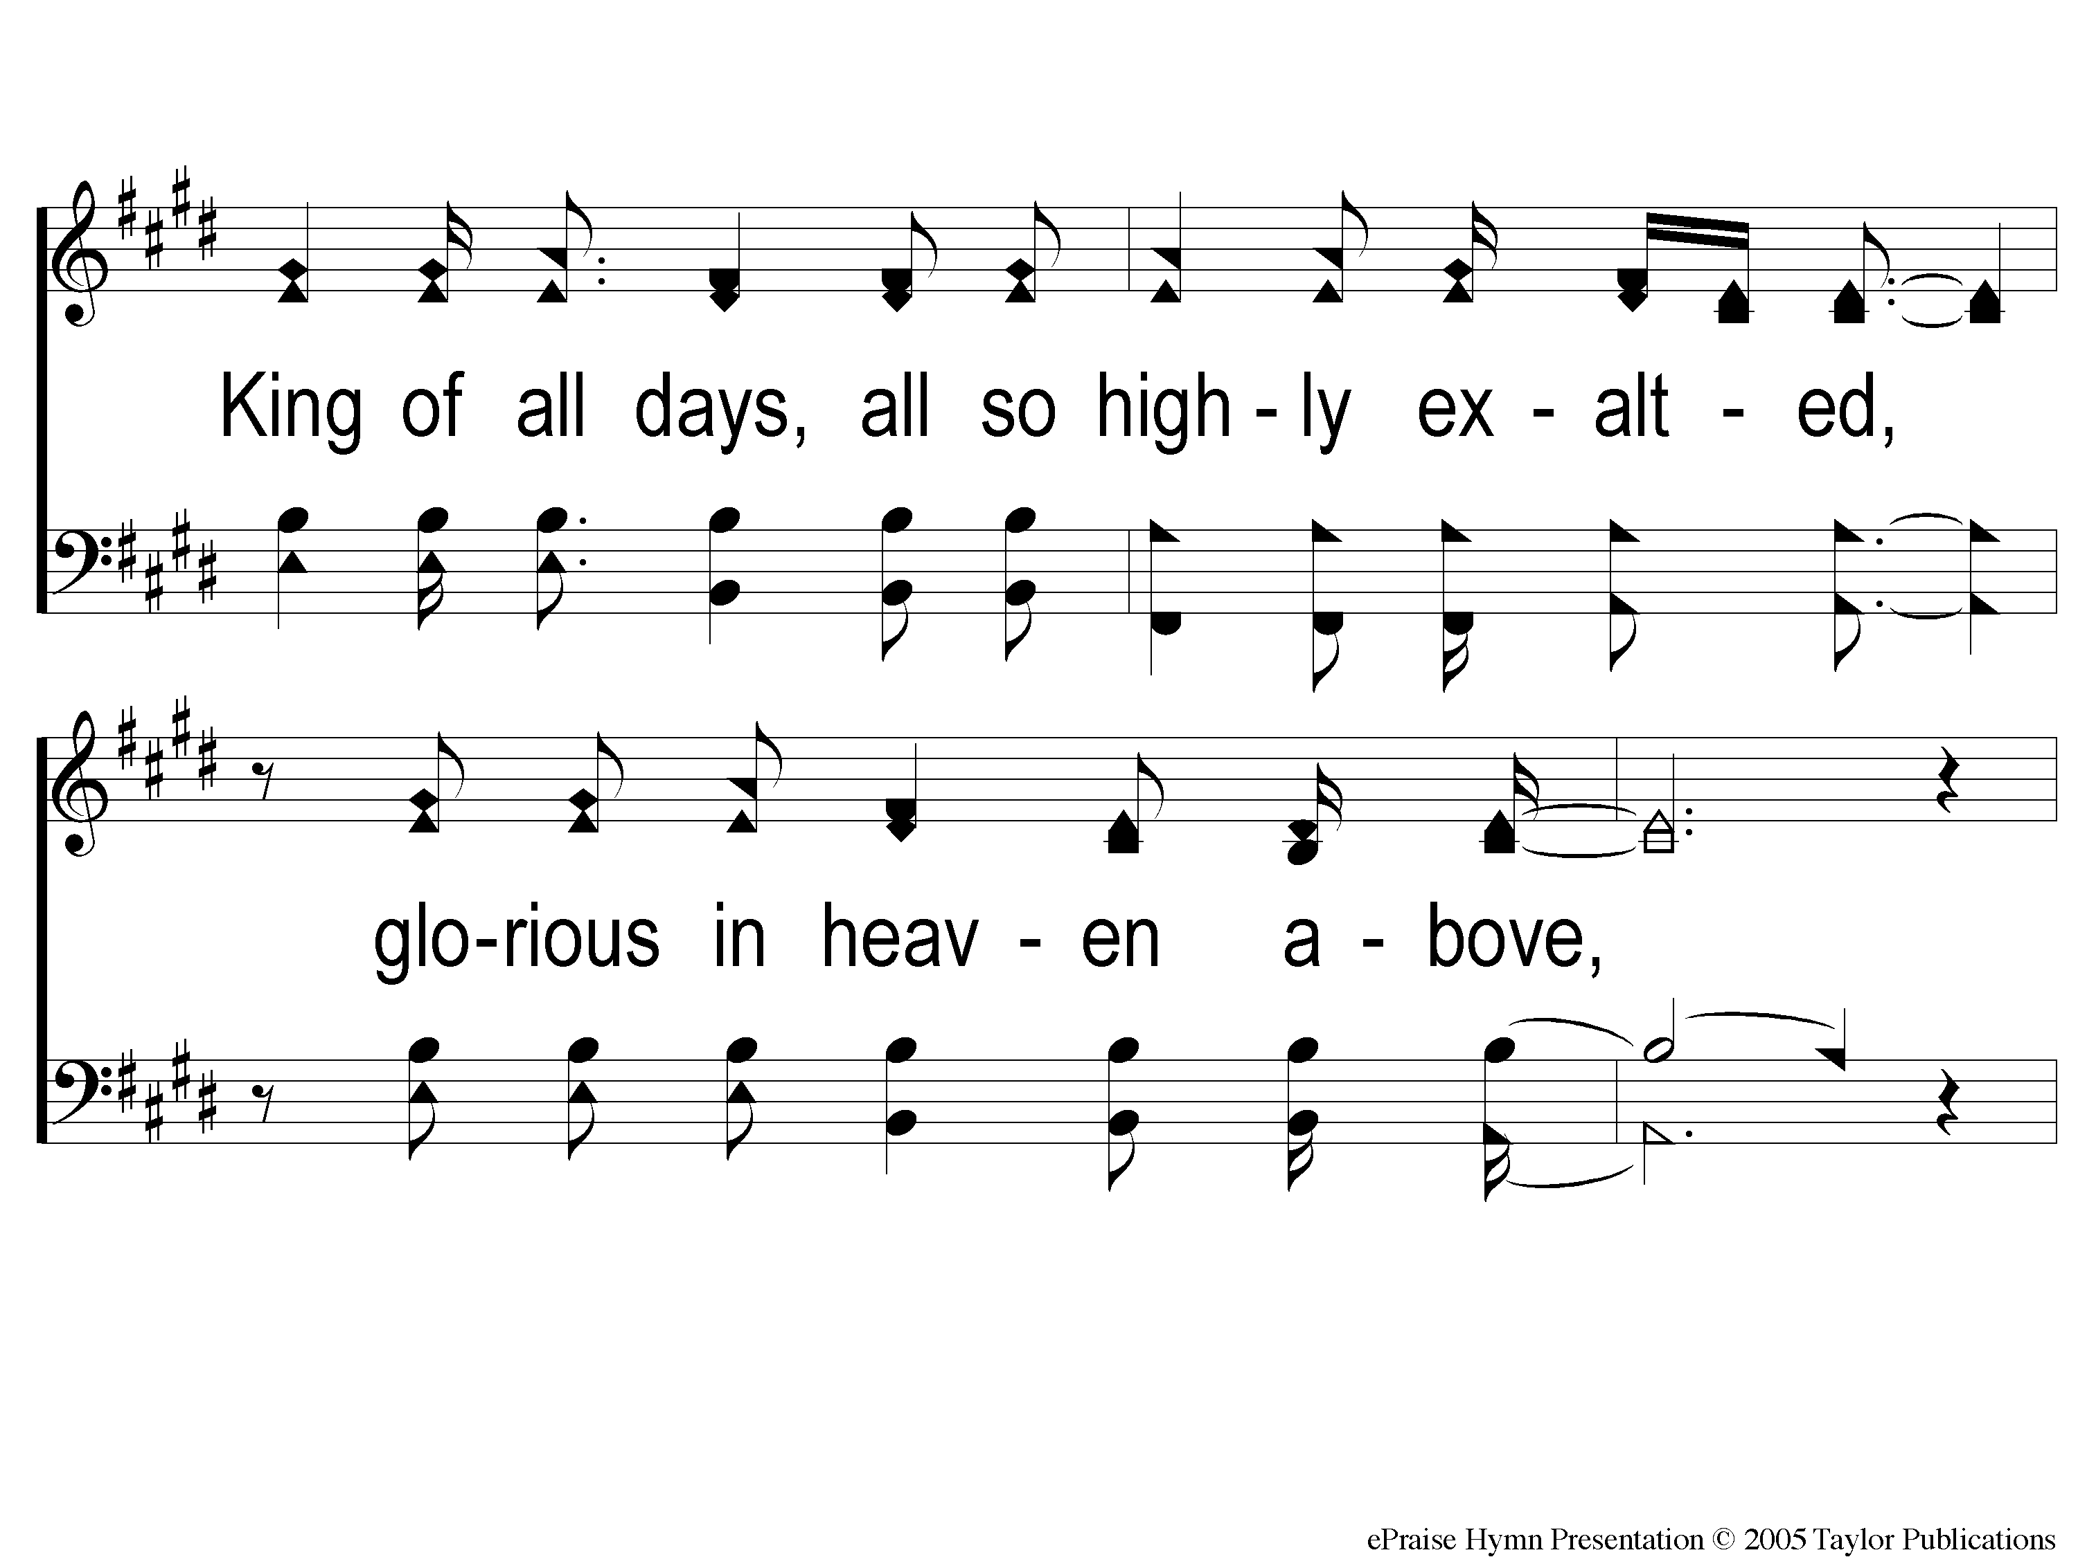
2-1 Here I Am To Worship
Here I Am To Worship

Slide 6
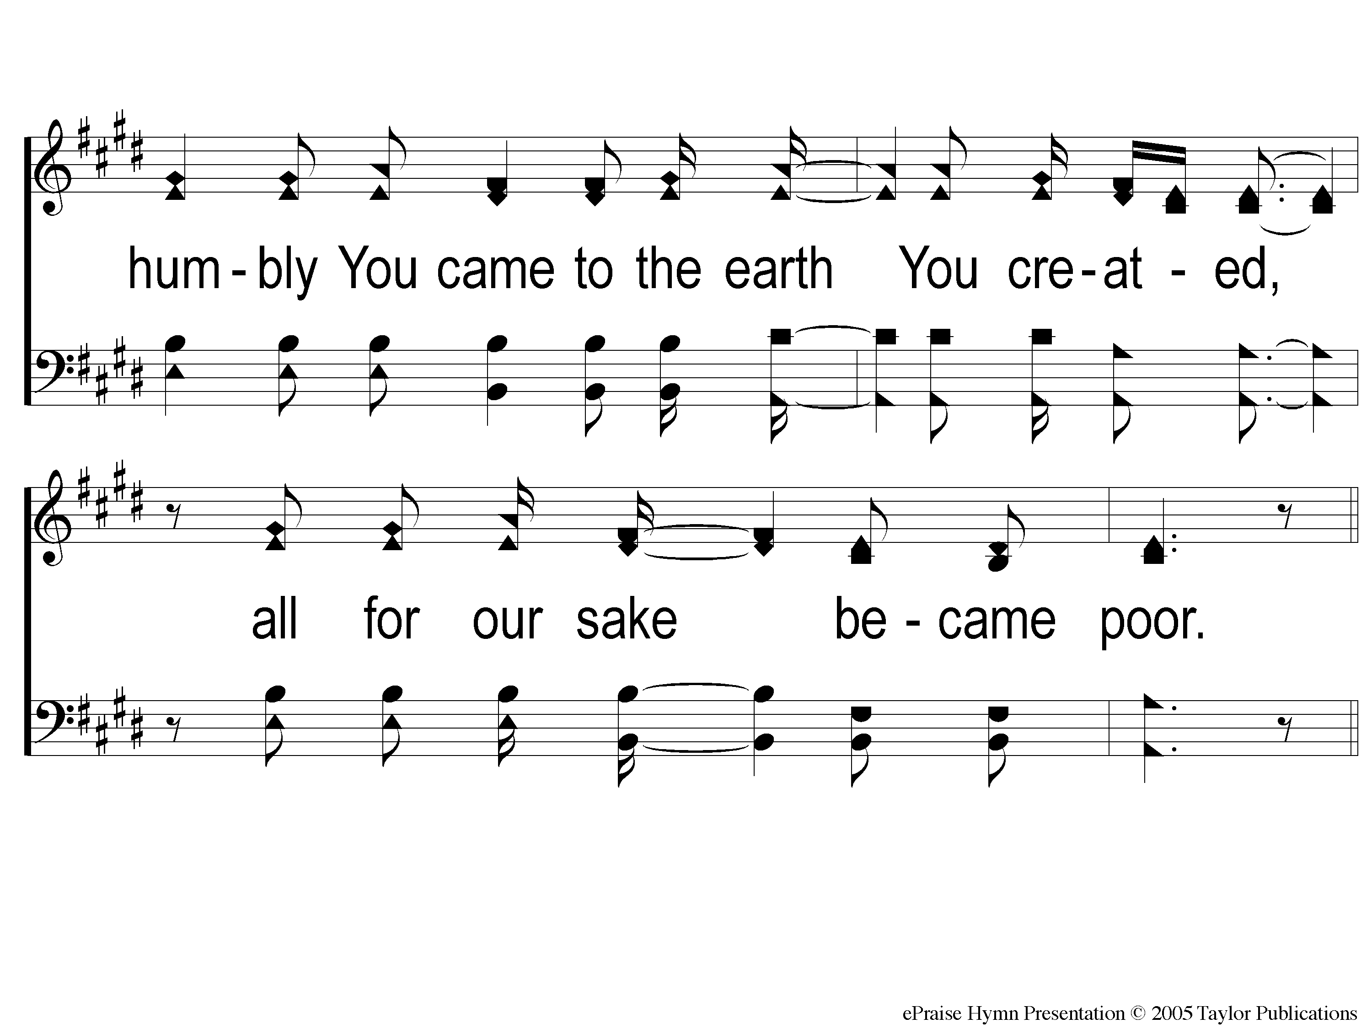
2-2 Here I Am To Worship
Here I Am To Worship

Slide 7
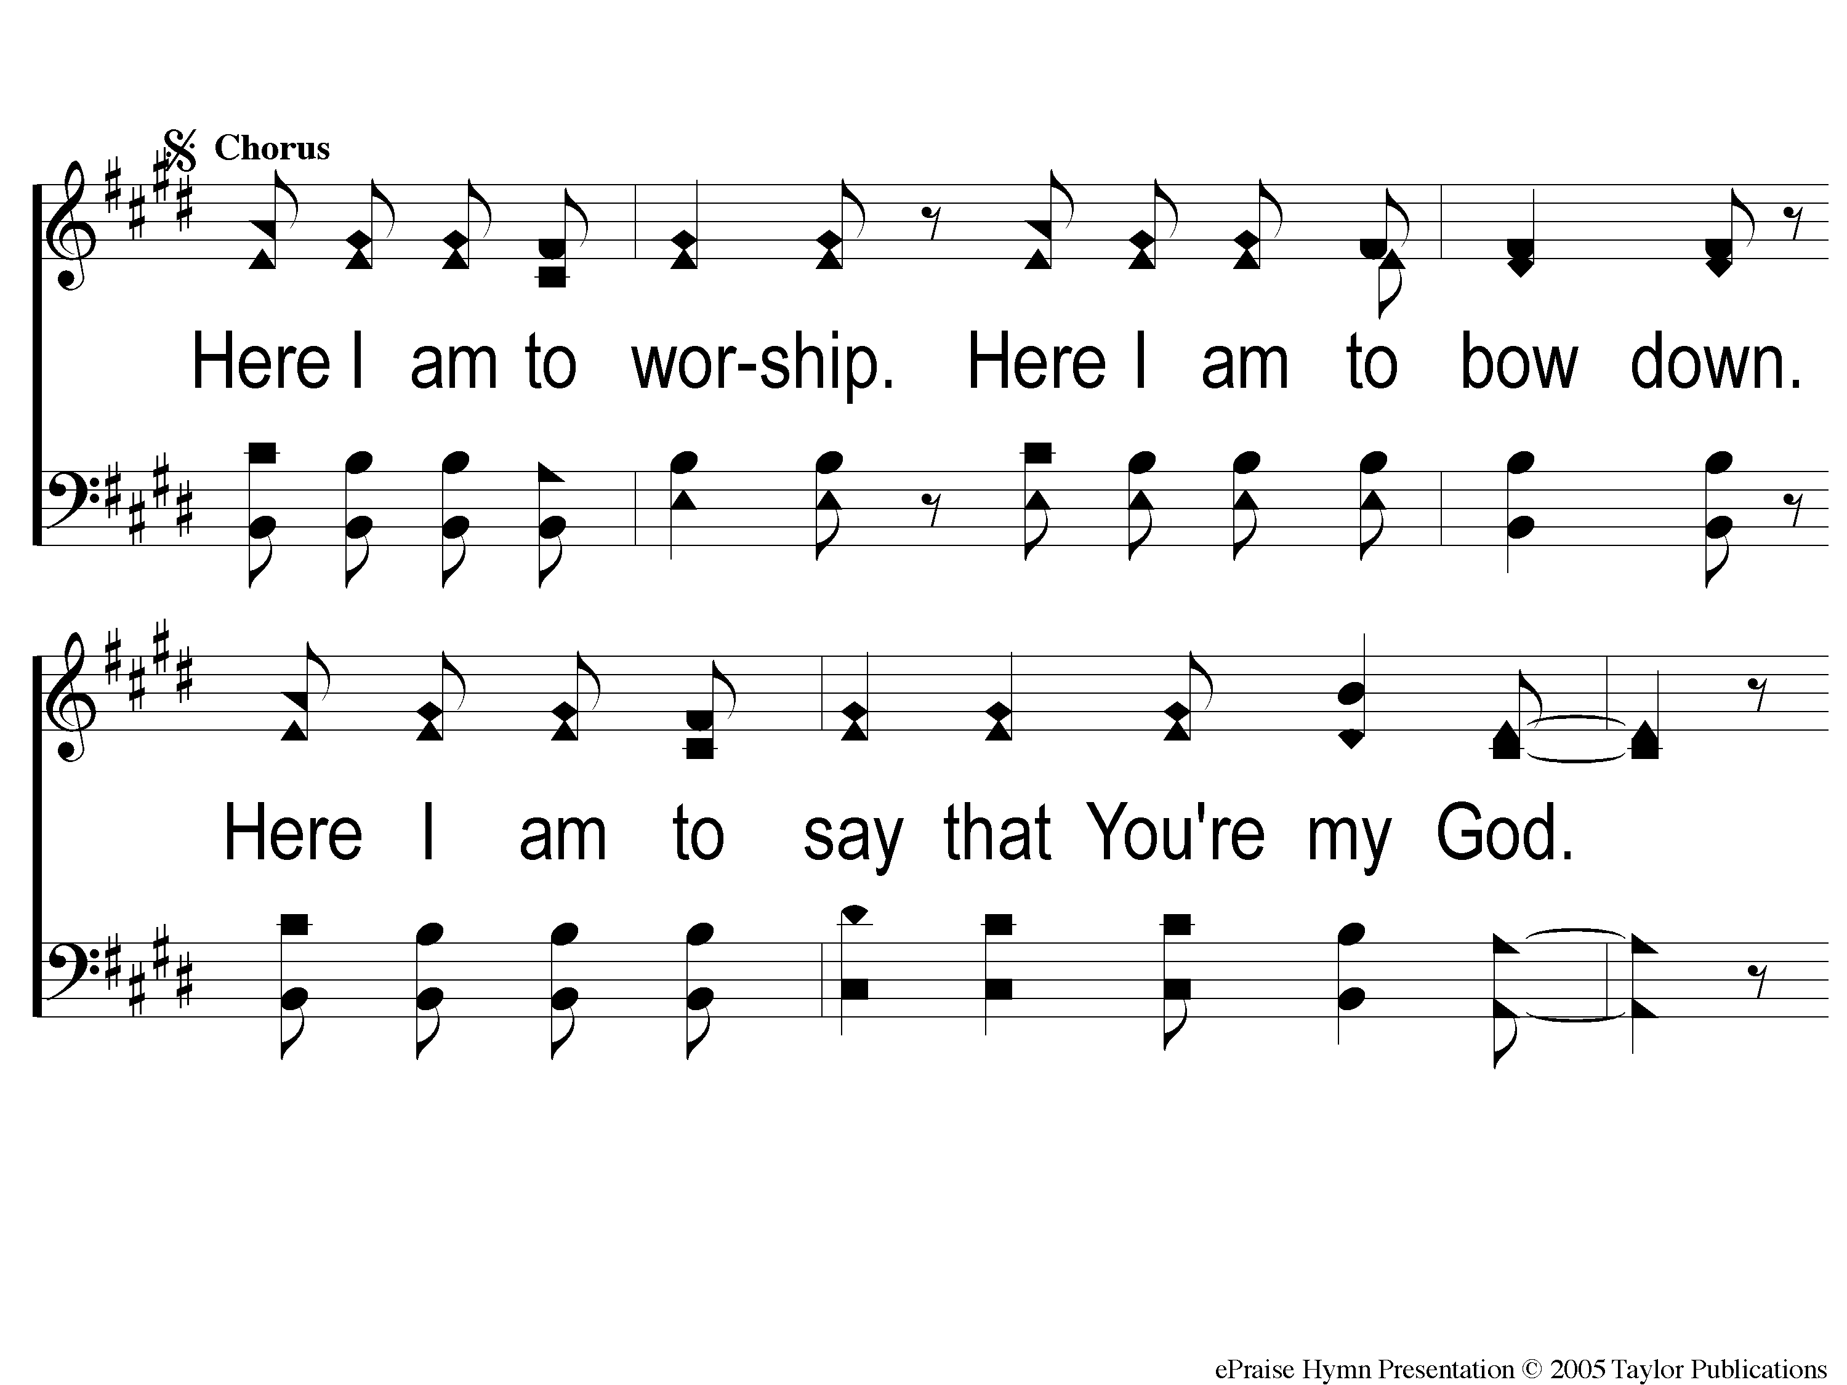
C2-1 Here I Am To Worship
Here I Am To Worship

Slide 8
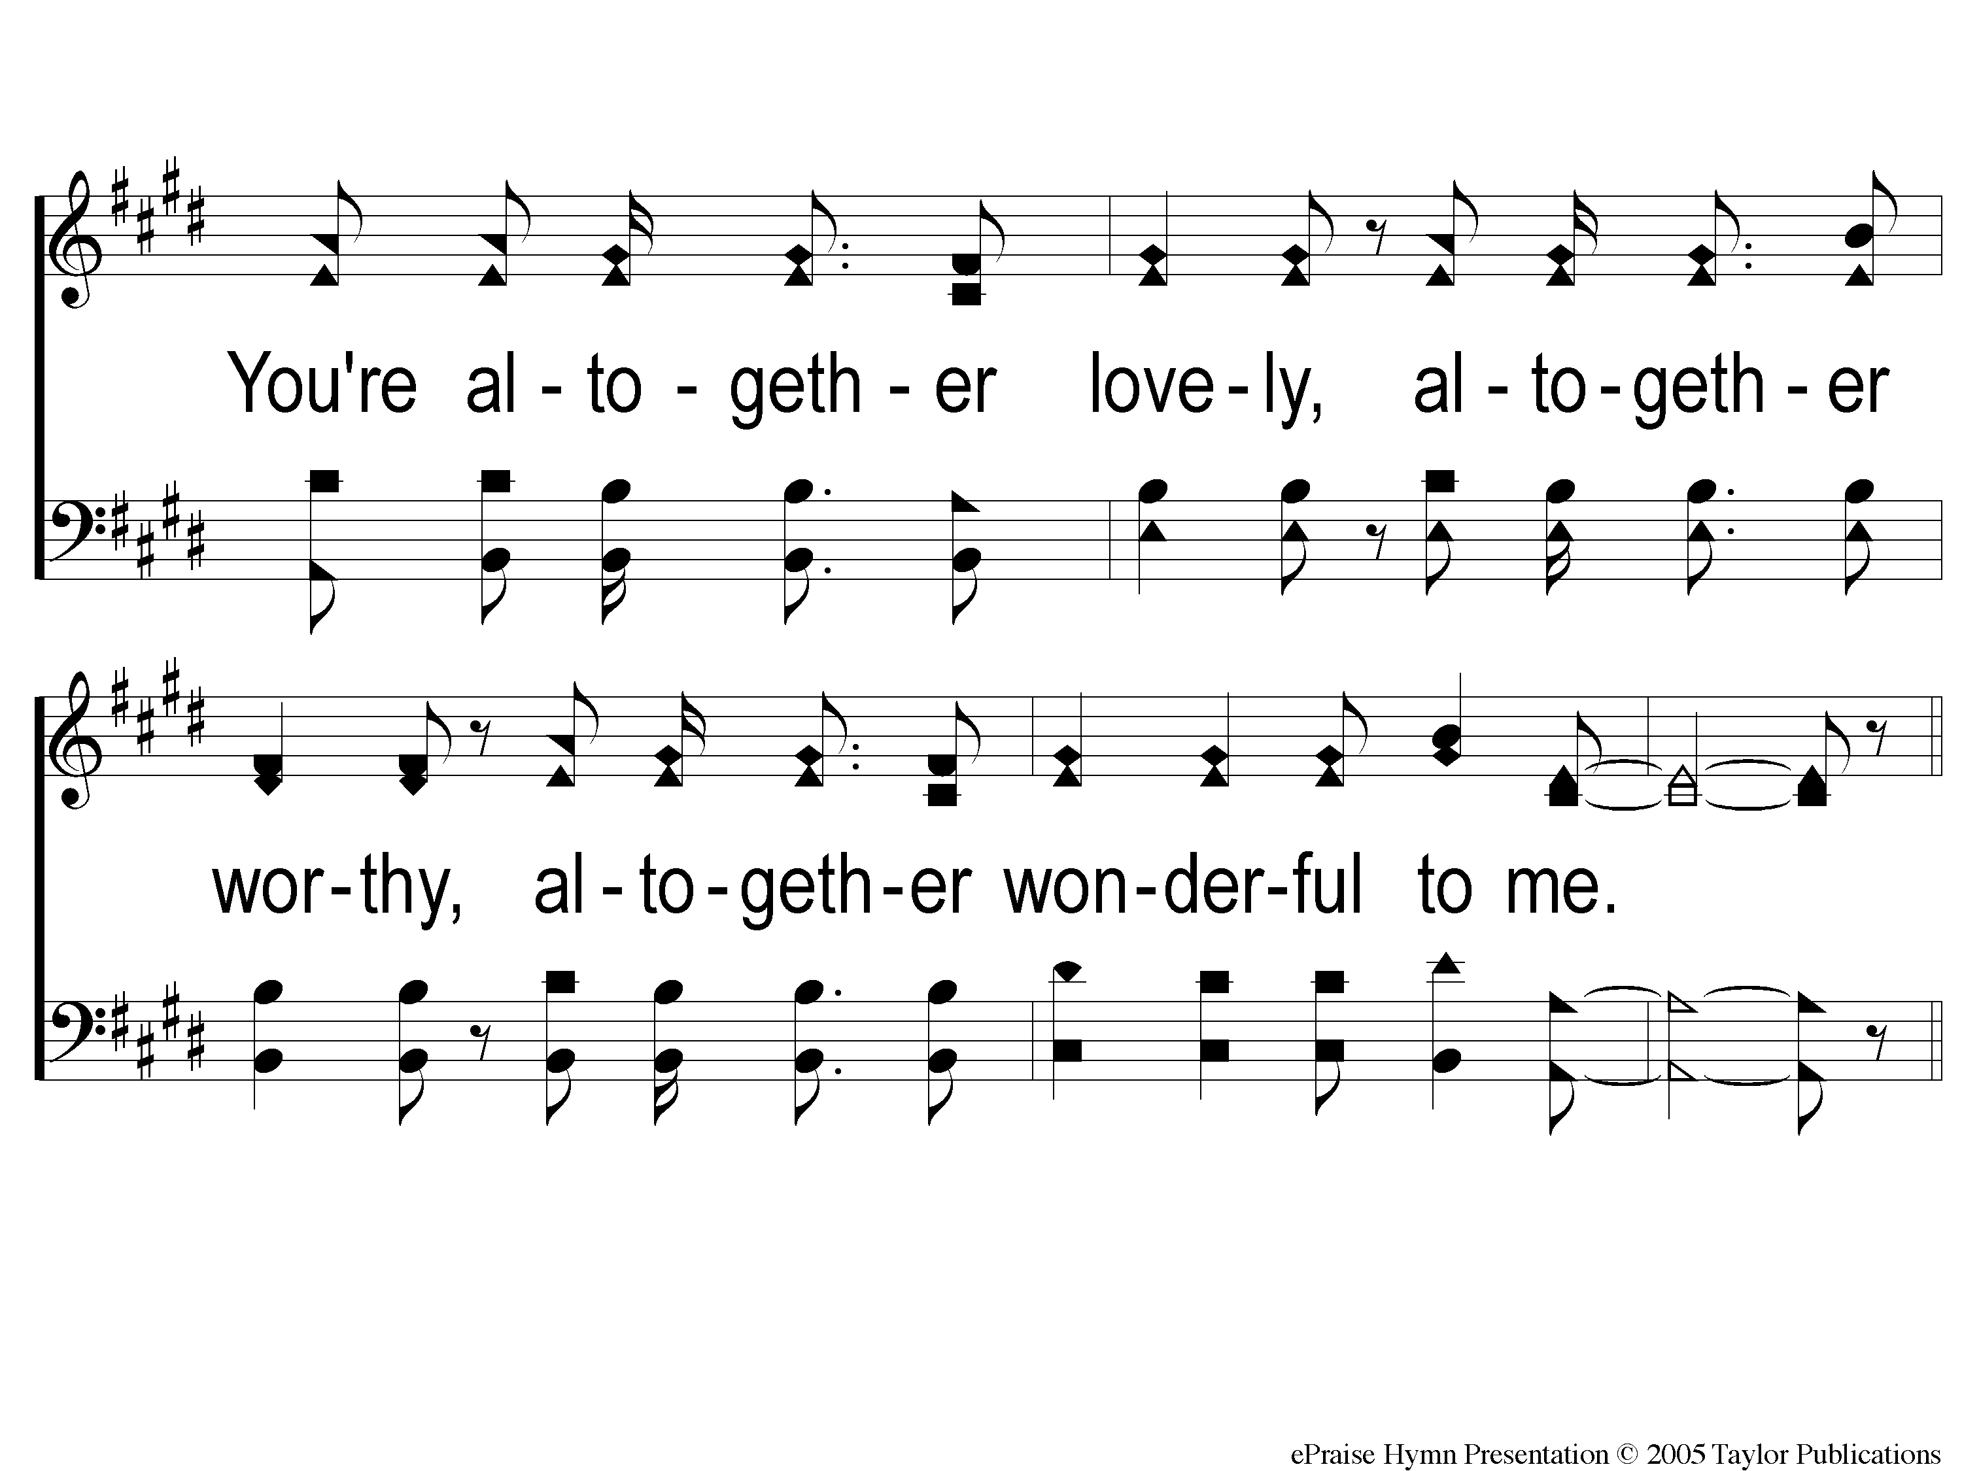
C2-2 Here I Am To Worship
Here I Am To Worship

Slide 9
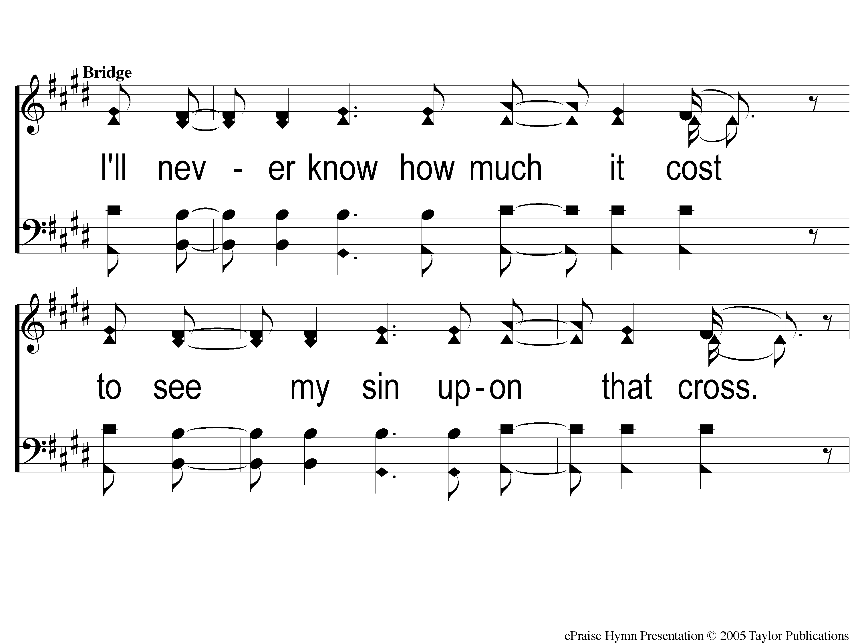
Bridge1 Here I Am To Worship
Here I Am To Worship

Slide 10
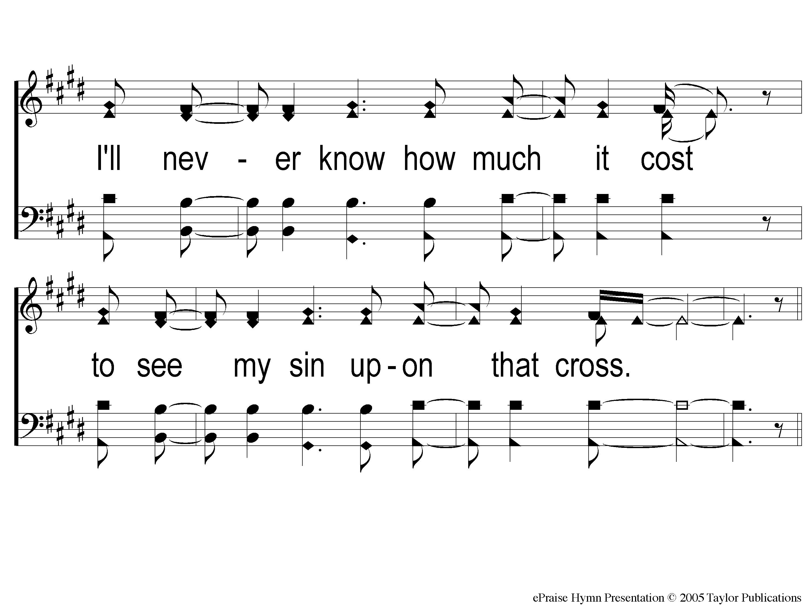
Bridge2 Here I Am To Worship
Here I Am To Worship

Slide 11
C2-1 Here I Am To Worship
Here I Am To Worship

Slide 12
C2-2 Here I Am To Worship
Here I Am To Worship

Slide 13
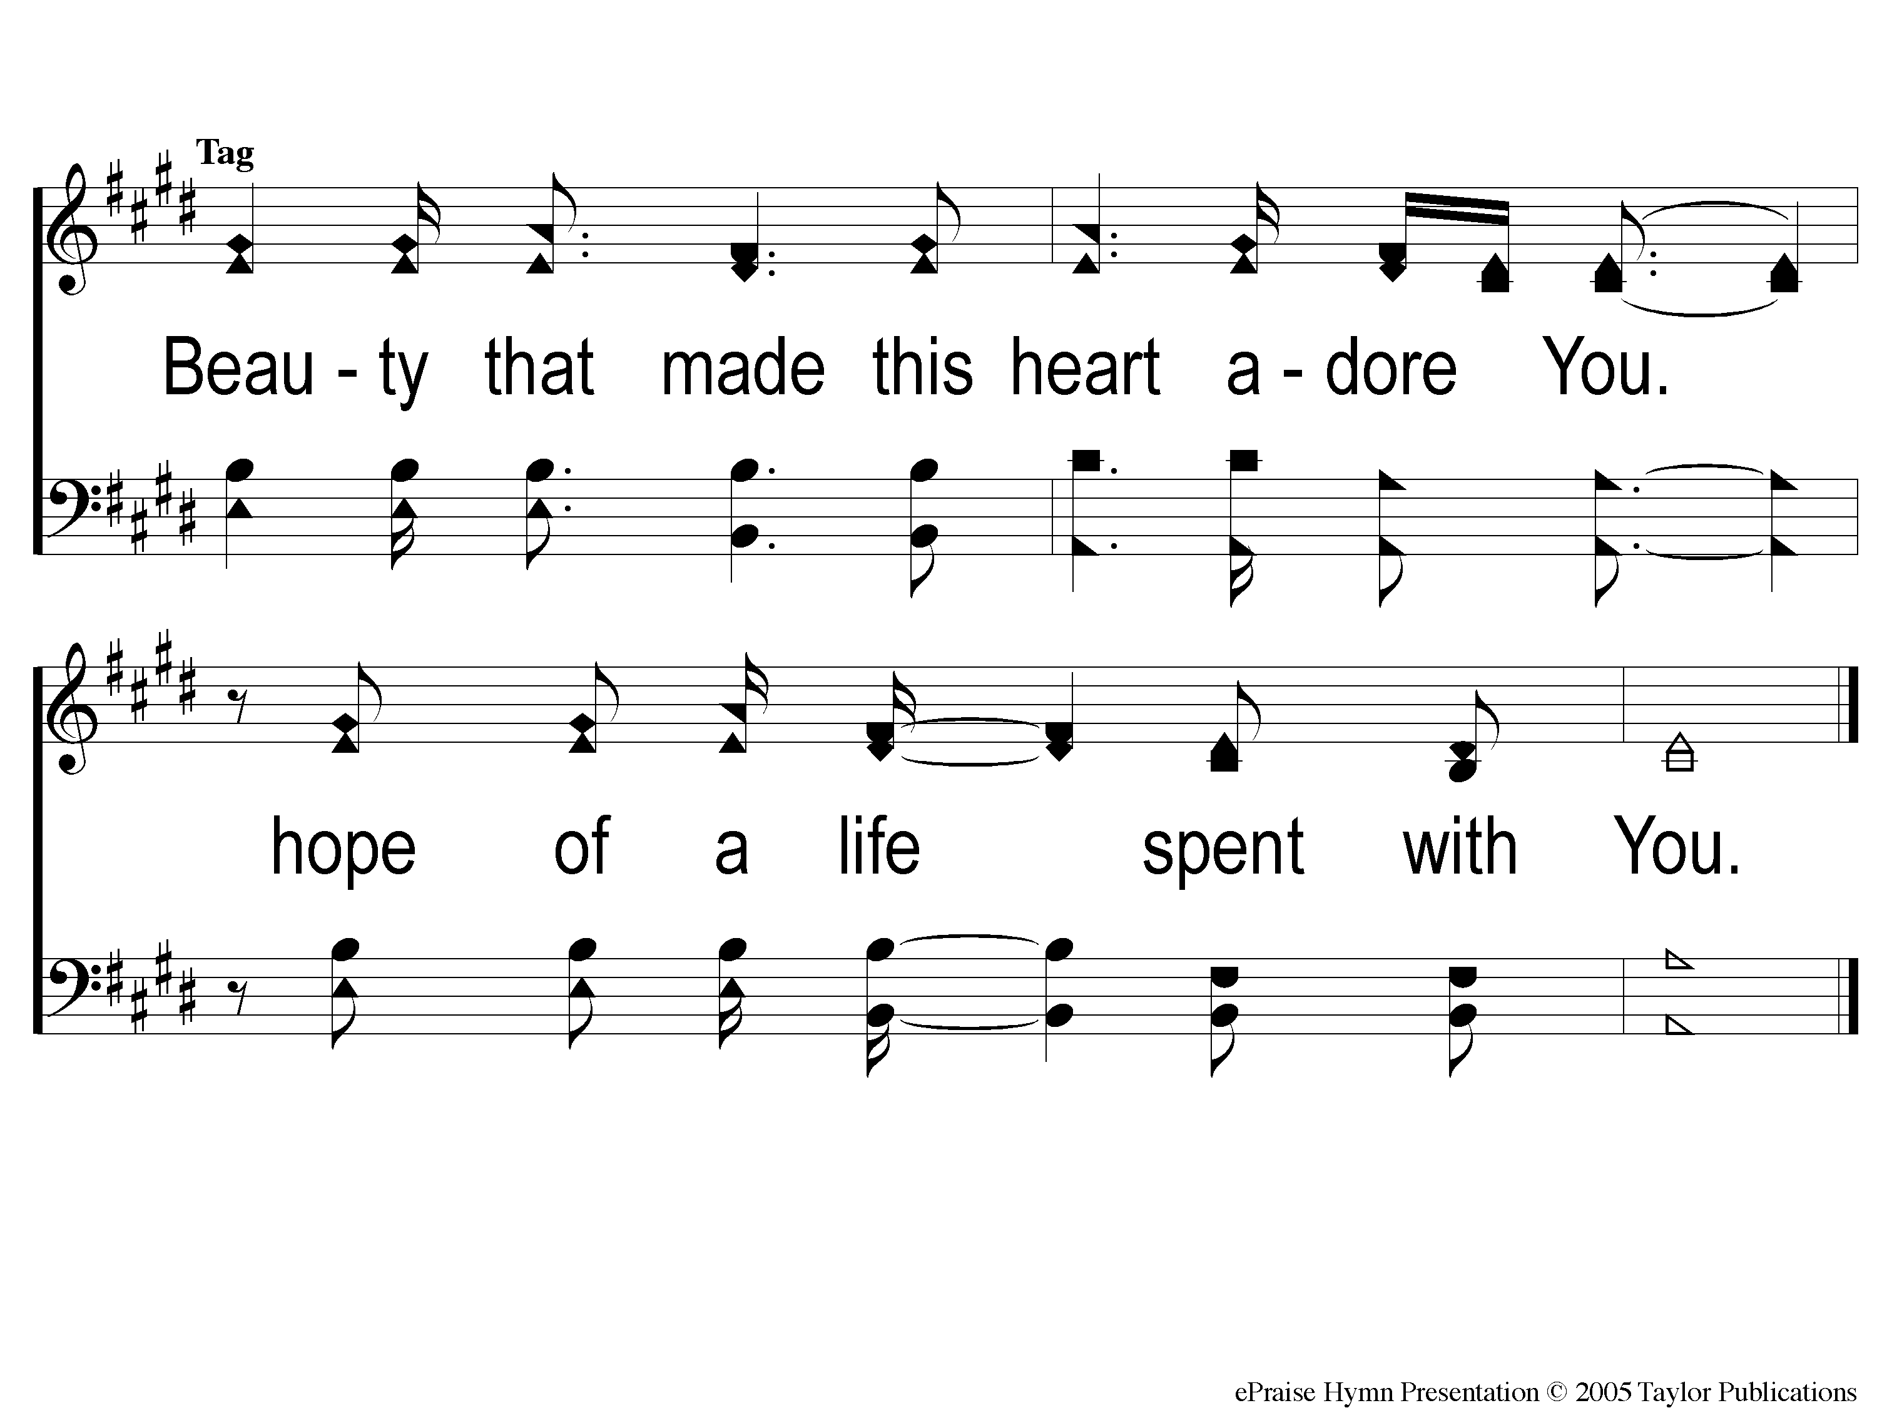
tag Here I Am To Worship
Here I Am To Worship

